Slide 1
MOTOR ASSEMBLY MONITORING THROUGH IMAGE ANALYSIS PROJECT ID-IN02
Team Members-
1)Arpan Kumar
4th year ECE
Academy of technology
2) Ayush Kumar
4th year EEE
Academy of technology
Team Mentor- Mr. Anik Sardar
Manager :Sensor QC & Calibration
Prophecy Sensorlytics India PVT.LTD.

Slide 2
Problem Statement
The project focuses on developing an image analysis system to monitor the correct insertion of magnets into the rotor slots of a motor during assembly. Additionally, it includes a 3D surface scanning component to evaluate the surface roughness and depth variability of the motor post-assembly. The goal is to leverage advanced computer vision techniques to automate quality control processes, thereby reducing the reliance on manual inspections and enhancing overall production efficiency.

Slide 3
Work Approach
Data Collection and Preprocessing:
Gather stereo and RGB images of motor assemblies, including both properly placed and misaligned magnets.
Convert RGB images to grayscale and preprocess them for noise reduction.
Image Comparison Algorithms:
Develop algorithms using Structural Similarity Index (SSIM) to compare test images against reference images.
Implement pixel-wise difference calculations to quantify deviations.
Depth Analysis Using Stereo Images:
Generate disparity maps from stereo images to analyse depth discrepancies.
Utilize depth analysis techniques to detect improperly inserted magnets.

Slide 4
4. 3D Surface Scanning and Roughness Analysis:
Extract 3D data from stereo images to create a point cloud representation of the motor surface.
Analyse surface roughness and depth variability using statistical methods.
5. Decision-Making System Development:
Create a threshold-based system to automatically flag assembly or surface quality issues based on analysis metrics.
Analysed SSIM scores, insertion percentages, and surface roughness to make decisions on assembly quality.
6. Reporting and Visualization:
Generated reports using matplotlib with visualizations to display the results.
Created quality control reports indicating any assembly or surface issues detected.

Slide 5
Work products and deliverables
Software Programs: Python scripts implementing image analysis, feature matching, depth analysis, and 3D surface scanning.
Datasets: Collection of stereo and RGB images showing different magnet alignment conditions.
Input folder name of images-new_images
reference image name-magnet_insertion-proper.jpg
GitHub Repository: A repository containing all source code, datasets, and documentations are present in this link: https://github.com/arpankumar2520/IDEAS_TIH_Project/tree/my-new-branch

Slide 6
User Manual
Installation Requirements:
Ensure Python is installed on your system.
Install Jupyter Notebook.
Install necessary libraries using the command:
pip install opencv-python scikit-image matplotlib.
2. Running the Application:
Execution:
Run the main() function in the provided script.
Specify the path for the reference image is “magnet_insertion-proper.jpg” and the folder with “new_images” which is containing the test images.
Output:
View the results, including SSIM scores, surface roughness values, and insertion percentages.
Check the automatically generated reports indicating quality control issues.

Slide 7
Technical Manual
Datasets:
Captured Images: Stereo and RGB images of motor assemblies for analysis.
Software Libraries Used:
OpenCV: Image processing and feature matching.
scikit-image: SSIM calculation and surface roughness analysis.
Matplotlib: Visualization of SSIM score distributions and analysis results.

Slide 8
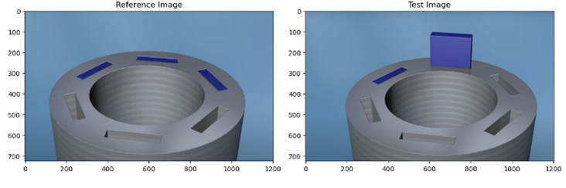
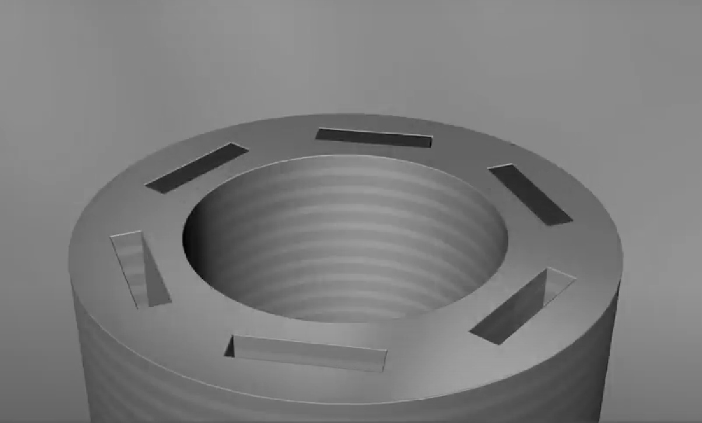
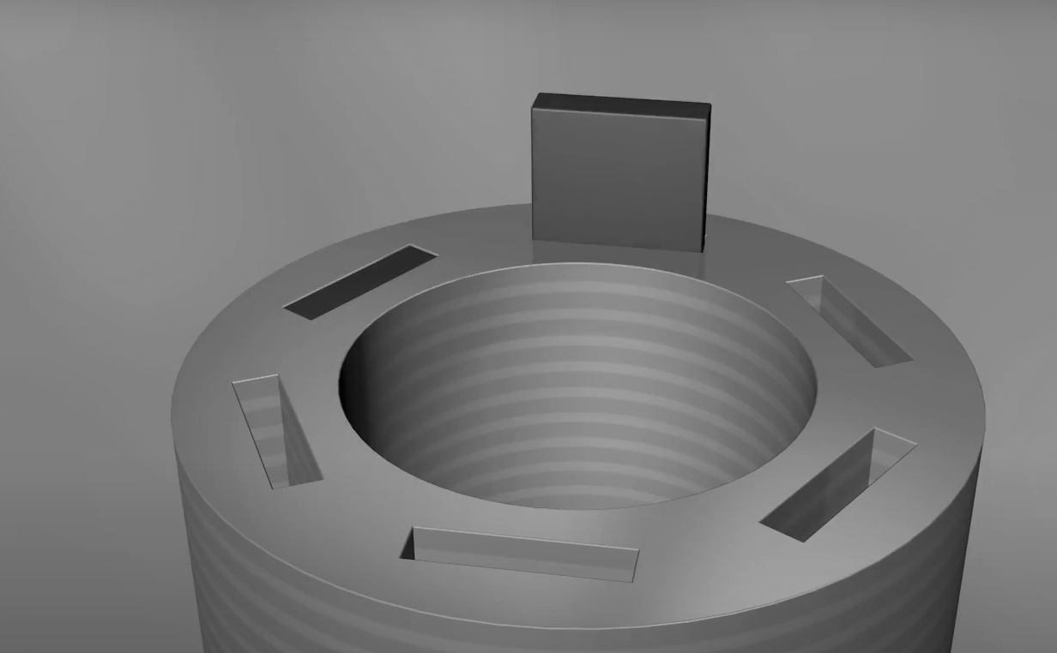
Program Documentation:
load_and_preprocess_images: Loads images, resizes the test image to the reference image’s.
YES
Start
[Loading & preprocessing]
Load Reference and Test Images [use cv2.imread(ref_path) & cv2.imread(test_path)]
Raise an Error for indicating the false path
Resize Test Image [use cv2.resize]
NO
Return Processed Images [Return ref_images, test_image_resized, ref_gray, and test_gray for analysis]
Convert Image to Grayscale [Apply cv2.cvtColor]
End

Slide 9
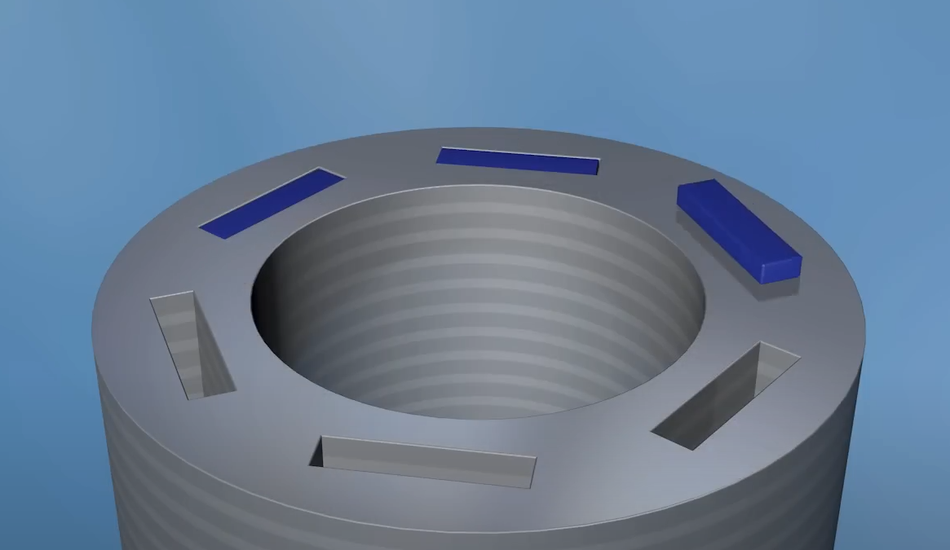
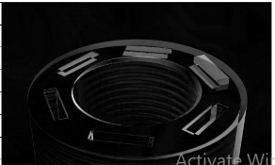
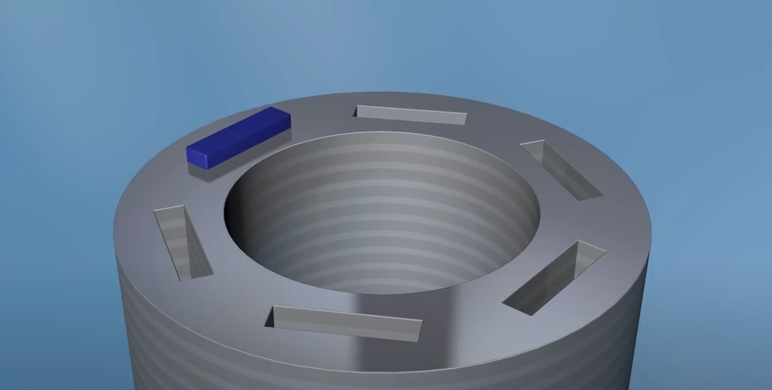
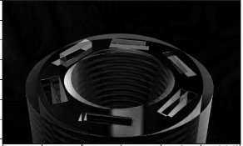
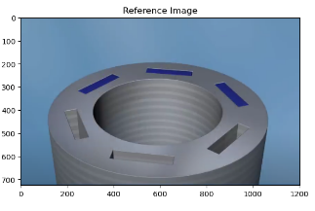
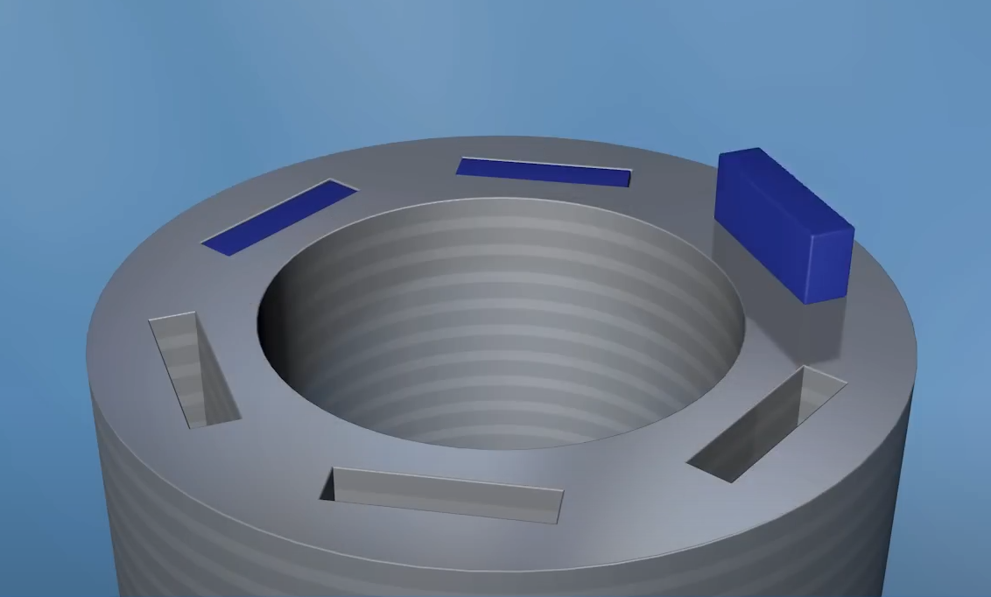
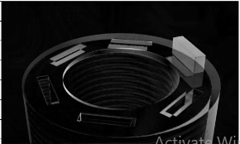
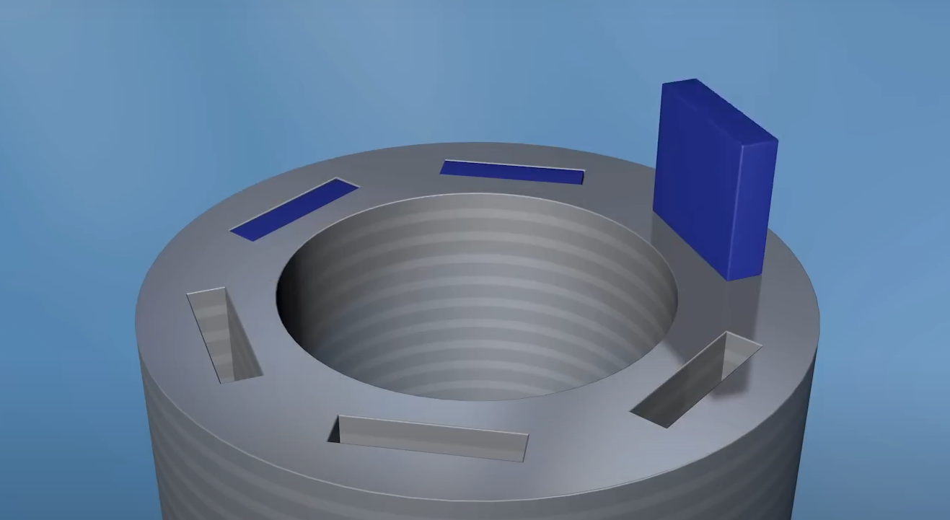
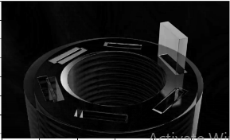
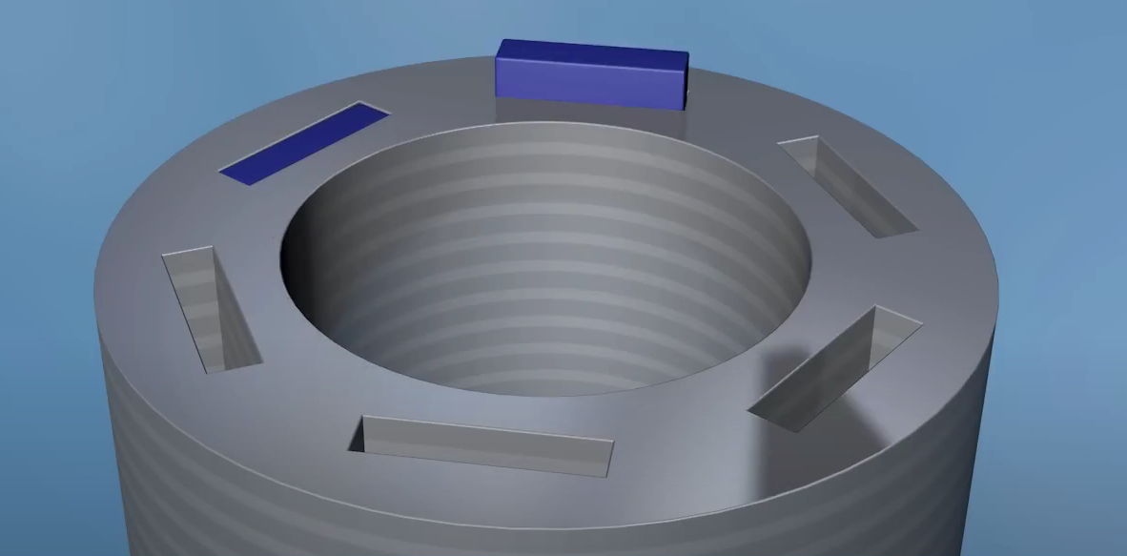
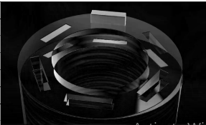
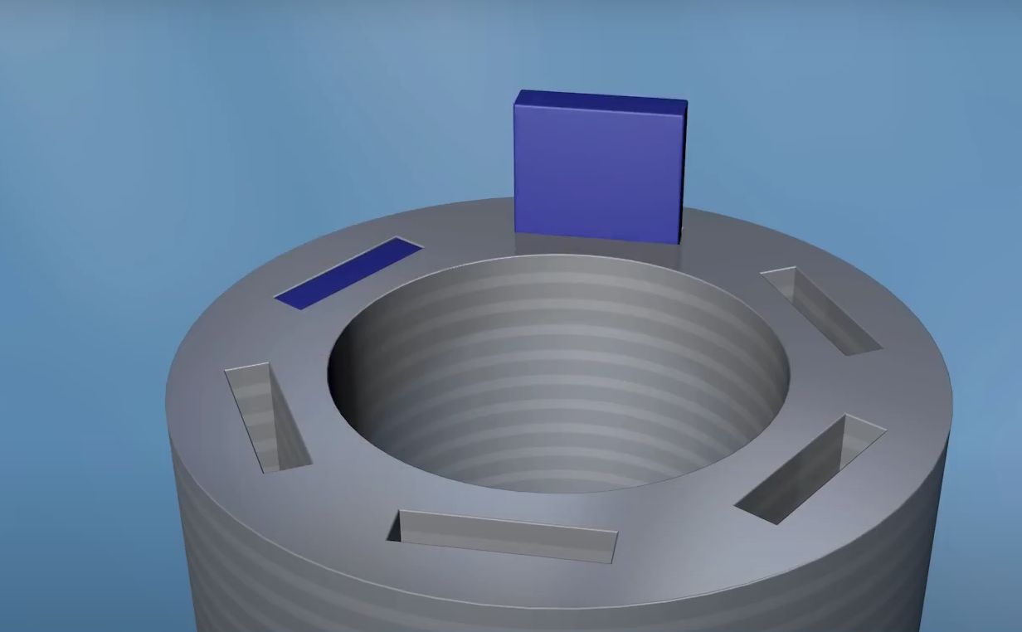
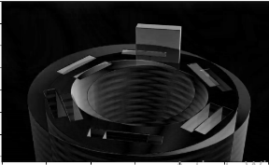
compare_images: Calculates SSIM between reference and test images.
Start [Image comparison process]
Calculate Structural Similarity Index (SSIM) [The SSIM between the Reference and test grayscale images.]
Normalize Difference Image [Convert the normalized difference(scales the pixel values to a standard range (0-255) ) image to an 8-bit unsigned integer format.]
Calculate Pixel-wise Differences [Use function cv2.absdiff(ref_gray, test_gray)]
Reference Image | Test Image | SSIM | Pixel-wise Difference
 |  | 0.8765
 |  | 0.8701
 |  | 0.8669
 |  | 0.8753
 |  | 0.8539
 |  | 0.8708
End
Return Results [normalized diff. image and SSIM score]
SSIM measures the structural similarity between two images, with values ranging from -1 to 1. A score of 1 indicates identical structures, while values near 0 suggest significant differences. High SSIM in motor assembly analysis suggests correct alignment, whereas low SSIM indicates potential assembly errors .Here SSIM score for fully inserted magnet: 1.0000 and for test images approximated SSIM is 0.8689 and all values lies within 0.8 value ranges gives some assembly errors.
Pixel-wise Difference: This step calculates pixel-wise differences and normalizes them, highlighting mismatched regions between reference and test images. By scaling pixel values (0-255), subtle differences become more visible. In motor assembly, this difference image helps identify misalignments, defects, or positioning errors that SSIM alone may not reveal. Here all images show the misalignment of the magnets.
Fig: Displaying SSIM

Slide 10
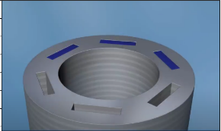
determine_ssim_threshold: Determines the SSIM threshold for classifying assembly accuracy.
Calculate Mean of SSIM Scores [using np.mean(ssim_scores)]
Calculate Standard Deviation of SSIM Scores
Determine Threshold (Mean + Standard Deviation) [Set threshold = mean_ssim + std_ssim to determine the SSIM threshold]
Start [Begin SSIM threshold calculation]
Reference Image | Test Image | SSIM | Threshold(mean + deviation) | Threshold(mean +2 * deviation) | Threshold(mean +3 * deviation)
 |  | 0.8765 | 0.9286 | 0.9729 | 1.0172
 |  | 0.8701 | 1.0000 | 1.0649 | 1.1299
 |  | 0.8669 | 0.9326 | 0.9799 | 1.0271
 |  | 0.8753 | 0.9388 | 0.9892 | 1.0396
 |  | 0.8539 | 0.9564 | 1.0166 | 1.0768
 |  | 0.8708 | 0.9459 | 1.0007 | 1.0555
Print Threshold [Calculate SSIM threshold for classification]
End
Here threshold provides a reliable way to determine acceptable similarity levels without needing arbitrary thresholds, which can be overly strict or lenient. This adaptive approach improves classification accuracy, making it highly useful in quality control applications where acceptable variation exists.
Reason for Taking the mean +std. deviation:
The value of both ssim and Threshold(mean + deviation) are coming out close and the other two Threshold(mean +2 * deviation) and Threshold(mean +3 * deviation) values differs more with the ssim i.e., why we chose the mean + std +deviation for thresholding.
Fig: Comparing different SSIM thresholding

Slide 11
analyze_surface and depth_analysis : Calculates surface roughness using standard deviation of the depth map. Generates disparity map for depth analysis.
Input Image [Input reference &Input test grayscale image]
To quantify surface roughness by measuring the standard deviation of pixel values in a depth map, providing insight into texture consistency.
Surface roughness analysis helps identify defects, ensure quality, and maintain smooth operation in assembled parts. This function provides a simple, effective measure for evaluating surface texture within quality control systems . Also we use disparity map (computes the horizontal displacement in each pixel between two images. ) for better analysis.
"The approximated surface roughness of the images is 22.3971." We use surface roughness values for decision-making, where we determine whether the magnet is inserted or not.
Depth Analysis [Compute the disparity map, use disparity_map = cv2.absdiff(ref_gray, test_gray)]
Output [Return disparity_map]
Surface Roughness values of all images
17.8853
20.1010
21.0387
17.6178
18.5573
18.5188
15.4731
35.9147
36.4679
Analyze Surface [Calculate surface roughness; use surface_roughness = np.std(depth_map)]
Output [print: surface roughness (Std Dev):{surface_roughness:.4f} ; Return surface_roughness]

Slide 12
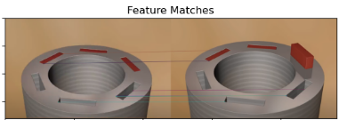
feature_matching: Matches features between the reference and test images using ORB.
Initialize ORB Detector [Create an ORB (Oriented FAST and Rotated BRIEF) detector using cv2.ORB_create)]
Create Brute-Force Matcher [Initialize a Brute-Force(BF) matcher with Hamming distance and descriptors.]
Detect Keypoints and Compute Descriptors in Reference and Test Image [Identify keypoints and compute descriptors for the reference & Test grayscale image.]
Start [Begin feature matching process]
End
Return Results
Sort Matches by Distance [Matches by their distance attribute to prioritize closer matches.]
Match Descriptors Between Reference and Test Images [Find Matches between descriptors]
The feature matching function uses ORB algorithm to detect and describe distinctive features in a reference and test image. It matches these features with Brute-Force matching, then sorts them by similarity. This enables image comparison, useful in quality control to check if a test image resembles the reference, helping identify missing or misaligned components.
From the feature_matching function, we obtain:
Matches: A list of matched features between the reference and test images, sorted by similarity. This allows us to assess how closely the two images resemble each other.
Keypoints: Key points (distinctive features) from both the reference and test images that help locate areas of similarity.
Fig: Feature matching

Slide 13
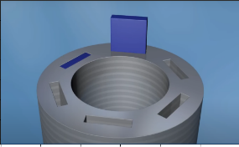
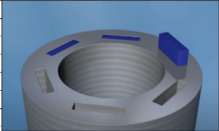
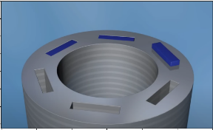
Reference Image | Test Image | Magnet insertion percentage | Alignment Score in %
magnet_insertion-proper.jpg | Processing: misfit-1.jpg | 1.45% | 87.01%
 | Processing: misfit-2_1.jpg | 1.44% | 86.08%
 | Processing: misfit-2_2.png | 1.93% | 85.39%
 | Processing: misfit-2_3.jpg | 1.29% | 87.08%
 | Processing: misfit-3_2.png | 3.01% | 86.69%
 | Processing: misfit-3_3.png | 2.40% | 87.65%
Magnet insertion percentage and alignment score
Start [Begin the process for magnet insertion percentage and alignment score calculations.]
Display Insertion Percentage
Define Threshold for Inserted Magnet [Set threshold = 50 to identify inserted magnet based on pixel intensity ]
Receive SSIM Index
& Calculate Alignment Score
Display Alignment Score
From these two functions, we obtain:
Magnet Insertion Percentage (determine_magnet_insertion): This function calculates the percentage of pixels in the test image that likely represent inserted magnets. By setting a pixel intensity threshold, it determines if a magnet is present based on darkness (lower pixel values). This percentage helps verify if the magnets are properly inserted in an assembly. It's values is used in decision making.
Alignment Score (calculate_alignment_score): This function calculates the alignment score based on the Structural Similarity Index (SSIM) between two images. The SSIM measures image similarity, so the alignment score (as a percentage) reflects how well the test image matches the reference image in structure, texture, and other characteristics.
Count Inserted Pixels
& Calculate Total pixels [Determine the total no. of pixels]
Return Results
Calculate Insertion Percentage [insertion_percentage = (inserted_pixels / total_pixels) * 100]
End

Slide 14
decision_making: Flags quality control issues based on thresholds for SSIM, insertion, and roughness.
Start [Begin the decision –making process]
Set Threshold Values
[ Define Thresholds:
threshold_ssim = 0.9, threshold_insertion = 0.0270 threshold_roughness = 22.39]
Check SSIM and Insertion Percentage [If ssim_index < threshold_ssim and insertion_percentage < threshold_insertion ; then print “low SSIM and magnet not fully inserted”]
Check Insertion Percentage [If insertion_percentage < threshold_insertion ; print ” Magnet not fully inserted”]
Check Surface Roughness [If surface_roughness > threshold_roughness ; print high surface roughness]
Assembly Acceptable [print “Decision: Assembly is acceptable”]
Check SSIM [ssim_index < threshold_ssim ; print “Assembly issue detected (low SSIM)”]
End
This decision-making function evaluates assembly quality based on three criteria: SSIM index, magnet insertion percentage, and surface roughness. It uses predefined thresholds for each criterion to detect potential issues. If any threshold is not met, it identifies specific problems, like low SSIM (poor alignment), incomplete magnet insertion, or high surface roughness. Otherwise, it deems the assembly acceptable.

Slide 15
GitHub Repository Structure
Reference image path: magnet_insertion-proper.jpg
Input folder path: new_images
Python code: main.py
Code pdf: main.pdf
Output image folder: output images.zip
Project report: MOTOR ASSEMBLY MONITORING THROUGH IMAGE ANALYSIS.pdf
Presentation: MOTOR ASSEMBLY MONITORING THROUGH IMAGE ANALYSIS.pptx

Slide 16
Relevance of the project to industrial applications.
The project "Motor Assembly Monitoring through Image Analysis" is highly relevant to industrial applications, particularly in the manufacturing sector. Here are some key aspects of its relevance:
Quality Assurance: By employing image analysis techniques to monitor motor assembly, manufacturers can ensure that each component is correctly positioned and fully inserted. This real-time monitoring reduces defects and improves overall product quality, essential for maintaining high standards in industrial applications.
Increased Efficiency: Automating the inspection process through image analysis significantly speeds up quality control compared to manual inspections. This efficiency allows for faster production cycles and the ability to identify and rectify issues immediately, minimizing downtime.
Cost Reduction: Detecting assembly issues early in the production process helps reduce costs associated with rework, waste, and product recalls. This project can lead to substantial savings for manufacturers by minimizing defects and improving yield rates.
Enhanced Data Analytics: The integration of image analysis with data analytics enables manufacturers to gather valuable insights regarding assembly processes. Analyzing metrics such as SSIM, insertion percentages, and surface roughness can lead to continuous improvement initiatives and better decision-making.
Flexibility in Production: The ability to adapt image analysis techniques to various types of motor assemblies makes this approach versatile. Manufacturers can implement these methods across different product lines, enhancing flexibility and responsiveness to market demands.
Compliance and Safety: In industries where safety is critical, such as automotive or aerospace, ensuring the integrity of motor assemblies is paramount. Image analysis provides an objective assessment, helping companies comply with industry regulations and safety standards.
Reduced Human Error: Automated inspection reduces reliance on human judgment, which can be prone to error, fatigue, or oversight. This leads to more consistent and reliable quality assessments.

Slide 17
Conclusion:
The program implements a comprehensive monitoring system for motor assembly through image analysis, focusing on magnet insertion quality. It begins by loading and preprocessing reference and test images, then compares them using the Structural Similarity Index (SSIM) and pixel-wise differences to evaluate assembly integrity. The system calculates various metrics, including surface roughness, magnet insertion percentage, and alignment scores, to assess the quality of assembly. Feature matching and depth analysis further enhance the understanding of discrepancies between the images. The decision-making module interprets these metrics against predefined thresholds to identify potential assembly issues, such as low SSIM values, incomplete magnet insertion, or high surface roughness. Finally, the program visualizes results and SSIM score distributions, enabling clear assessment of magnet insertion quality. This approach enhances quality control in manufacturing processes, ensuring that motor assemblies meet stringent standards for performance and reliability.
References:
Used tutorials: OpenCV, Matplotlib, scikit, python
YouTube- learned different thresholding techniques and Image Comparison Algorithms

Slide 18
THANK YOU

